Slide 1
Automatic Target Recognition for CT-based Airport Checkpoint Screening
Hetansh Patel, Meet Patel, Patric Kun

Slide 2
Index
Introduction
Data
Descriptor
Models
Summary
Future
Reference

Slide 3
Introduction

Slide 4
What is Automatic Target Recognition?
The use of computer algorithms and machine learning techniques to automatically detect, classify, and identify targets or objects of interest in images, videos, or other sensor data.
ATR systems are commonly used in various applications to automatically analyze and interpret sensor data for target identification or tracking.
For this project, we will be focusing on CT-based Airport Checkpoint Screening

Slide 5
Problem
The airports currently use 2-D X-ray-based screening to detect the object, which requires taking out laptops and 3-1-1 liquids from the bag during checkpoint screening. The reason is that liquids can obstruct the images of the X-ray screening machine. To avoid these problems, CT-based screening is getting popular. The CT-based screening produces a 3-D image that can be viewed and rotated 360 degrees for a comprehensive analysis. The goal is to keep laptops and 3-1-1 liquids inside the bag during checkpoint screening.

Slide 6
Goal
In this project, we will be exploring, implementing, and comparing a few supervised machine-learning algorithms that we learned in class to classify whether the image is saline, rubber, or clay from the 3D CT-based image dataset, and in case the image does not have any target, then it should predict it as a non-target to avoid false predictions.
To carry out this project, we used Python and its libraries to analyze and predict objects

Slide 7
Data

Slide 8
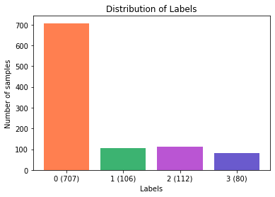

Slide 9
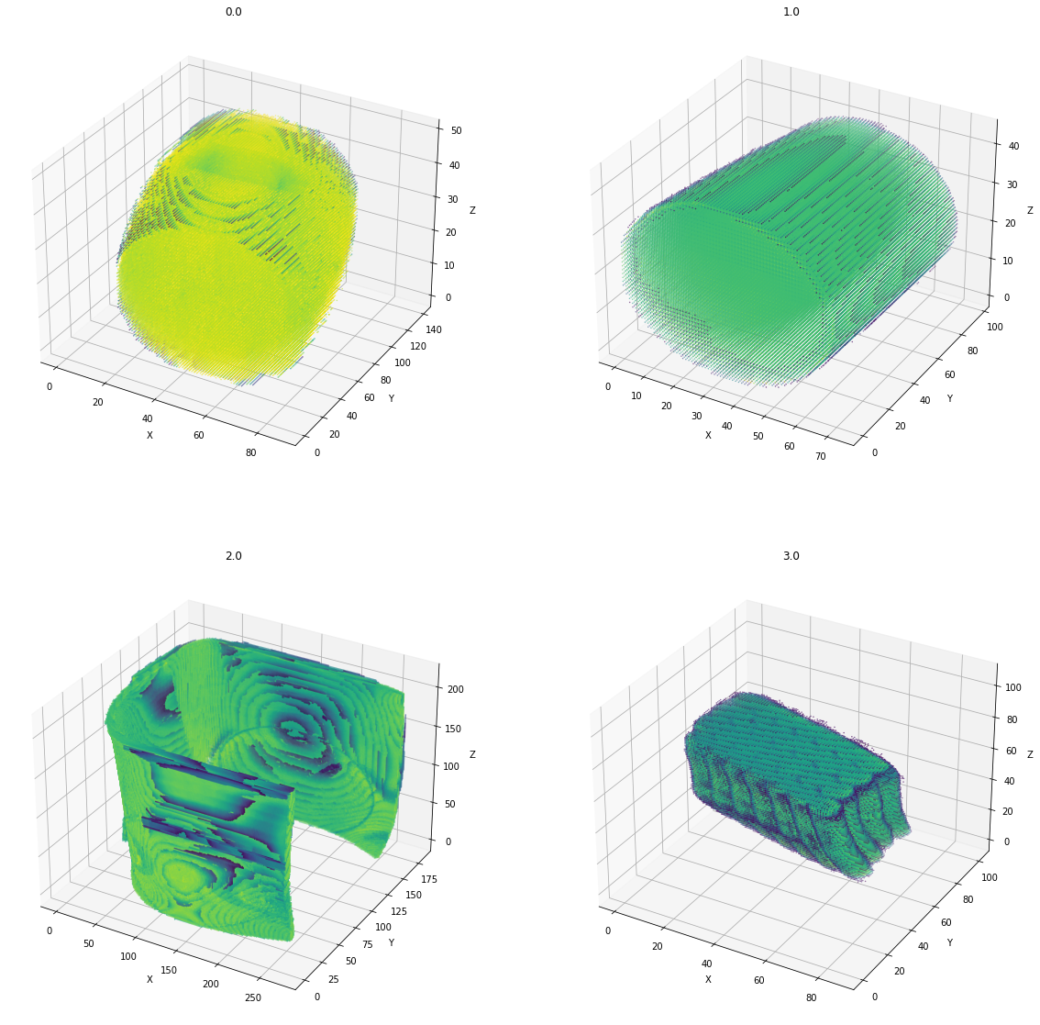

Slide 10
Descriptor

Slide 11
Histogram Features
Although images have different sizes and orientations, the texture, and pixel intensity of the images stay the same. So, we can take advantage of this observation, and use them as our features.

Slide 12
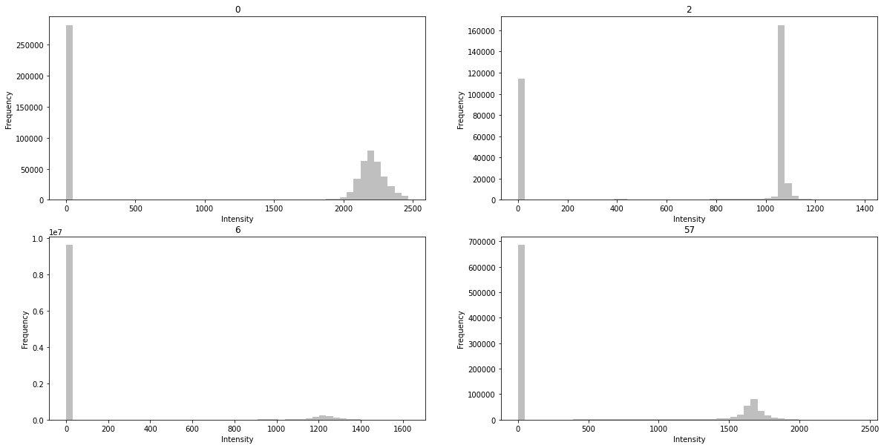

Slide 13
As you may have noticed there are too many zero values that can be considered as background, so we can ignore those values from our feature data to get a better model.

Slide 14
Models

Slide 15
Before we move on to the models, please be aware that we have performed hyperparameter tuning using GridSearchCV with 10-fold cross-validation to improve our models and pick the best parameters to train the models.

Slide 16
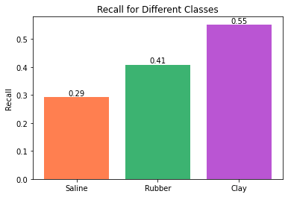
Logistic Regression
LogisticRegression(C=10,
Solver= Saga,
Penalty= Lasso,
Max iter=3000)
Recall Rate:0.41463 51/123
Precision Rate:0.88953 306/344
Saline Recall Rate:0.29268 12/41
Rubber Recall Rate:0.40909 18/44
Clay Recall Rate:0.55263 21/38

Slide 17
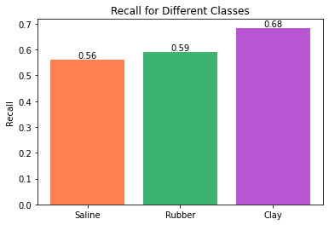
SVM
SVM(C = 5, Kernel = RBF)
Recall Rate:0.60976 75/123
Precision Rate:0.88081 303/344
Saline Recall Rate:0.56098 23/41
Rubber Recall Rate:0.59091 26/44
Clay Recall Rate:0.68421 26/38

Slide 18
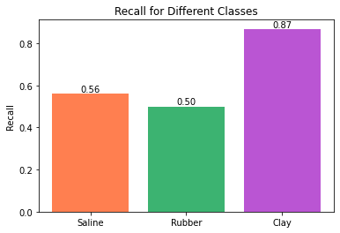
SVM with PCA
PCA(Components = 50)
SVM(C = 10, Kernel = RBF)
Recall Rate:0.63415 78/123
Precision Rate:0.87209 300/344
Saline Recall Rate:0.56098 23/41
Rubber Recall Rate:0.5 22/44
Clay Recall Rate:0.86842 33/38

Slide 19
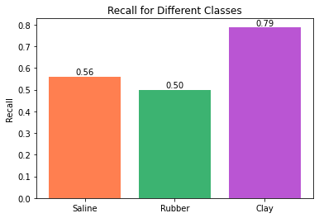
AdaBoost with Decision Tree
DecisionTree(Max Depth = 8,
Criterion = Gini,
Min Samples Split=2)
AdaBoost(Estimators=100)
Recall Rate:0.60976 75/123
Precision Rate:0.90698 312/344
Saline Recall Rate:0.56098 23/41
Rubber Recall Rate:0.5 22/44
Clay Recall Rate:0.78947 30/38

Slide 20
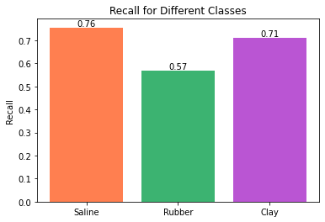
KNN
KNN(Metric=Manhattan,
Neighbors = 5,
Weights = Distance)
Recall Rate:0.6748 83/123
Precision Rate:0.82267 283/344
Saline Recall Rate:0.7561 31/41
Rubber Recall Rate:0.56818 25/44
Clay Recall Rate:0.71053 27/38

Slide 21
Summary

Slide 22
Based on the results, it can be concluded that the SVM with the PCA model and KNN model performed well in accurately classifying the 3D images. These models exhibited high precision rates and recall rates, indicating that they were able to correctly identify a high proportion of the positive samples while minimizing false positives.
On the other hand, the AdaBoost with the Decision Tree model had the highest precision rate but a lower recall rate. This suggests that while the model was able to accurately classify positive samples, it may have missed a proportion of positive samples. Further analysis is required to identify the specific sources of errors and improve the recall rate of this model.
Also, the Logistic Regression model had the lowest recall rate, indicating that this model may not be suitable for accurately classifying the 3D images.

Slide 23
Future

Slide 24
Basic Concept of YOLO
The YOLO algorithm first divides the input image into grids, called cells. Each cell is then used to predict bounding boxes and calculate probabilities for objects contained in those boxes.
Each cell is given a Confidence value which is calculated using the Intersection Over Union method and P(Object), which is set to 1 if the object is at the center of the cell and 0 if the object is not at the center.
By using these parameters YOLO shows where the object is present in the image.

Slide 25
YOLOV5 - State Of the Art
YOLOV5 is one of the latest releases of YOLO algorithms
It is available as an open-source code on GitHub.
All the models of YOLOV5 are composed of three components: CSP-Darknet53; Spatial Pyramid Pooling; PANet
CSP-DarkNet53 is the backbone that is used to overcome “redundant gradients” problem. It used DenseNet’s feature to reuse characteristics.
Spatial Pyramid Pooling(SSP) and PANet as neck of YOLOV5. They basically help in the localization of pixels.
In the end it uses YOLOV3 and YOLOV4 as head of the YOLOV5. It is composed of 3 Convolution layers.
Activation Function: SiLU and Sigmoid[2]

Slide 26
Future Work
Due to the computational cost of the object detection algorithm we faced some problems.
Therefore, we have decided that we will also try to predict accuracies for this project using a pre-trained network.
YOLOV5 is one of the most powerful object detectors out there. It has already been trained with a large dataset.
We can feed this model any kind of data from images to videos and get it to detect all the objects present in the data.
We need to initialize the algorithm with “weights” if we want more precise detections.
Another way to run this algorithm is to simply call it and feed it data.

Slide 27
Reference
[1] Redmon, Joseph & Divvala, Santosh & Girshick, Ross & Farhadi, Ali. (2016). You Only Look Once: Unified, Real-Time Object Detection. 779-788. 10.1109/CVPR.2016.91.
[2] https://iq.opengenus.org/yolov5/
​

Slide 28
THANK YOU

